Slide 1

SMART INDIA HACKATHON 2026
FLOOD MEMORY
AI-Powered Hyperlocal Flood Intelligence
&
Community Reporting System
Problem Statement ID: SIH260085.
Problem Statement Title: Urban Flood Nowcasting System (Drainage and Rainfall Coupling)
Theme: Disaster Management
PS Category: Software
Team ID: [Team ID]
Team Name: Hive

Slide 2
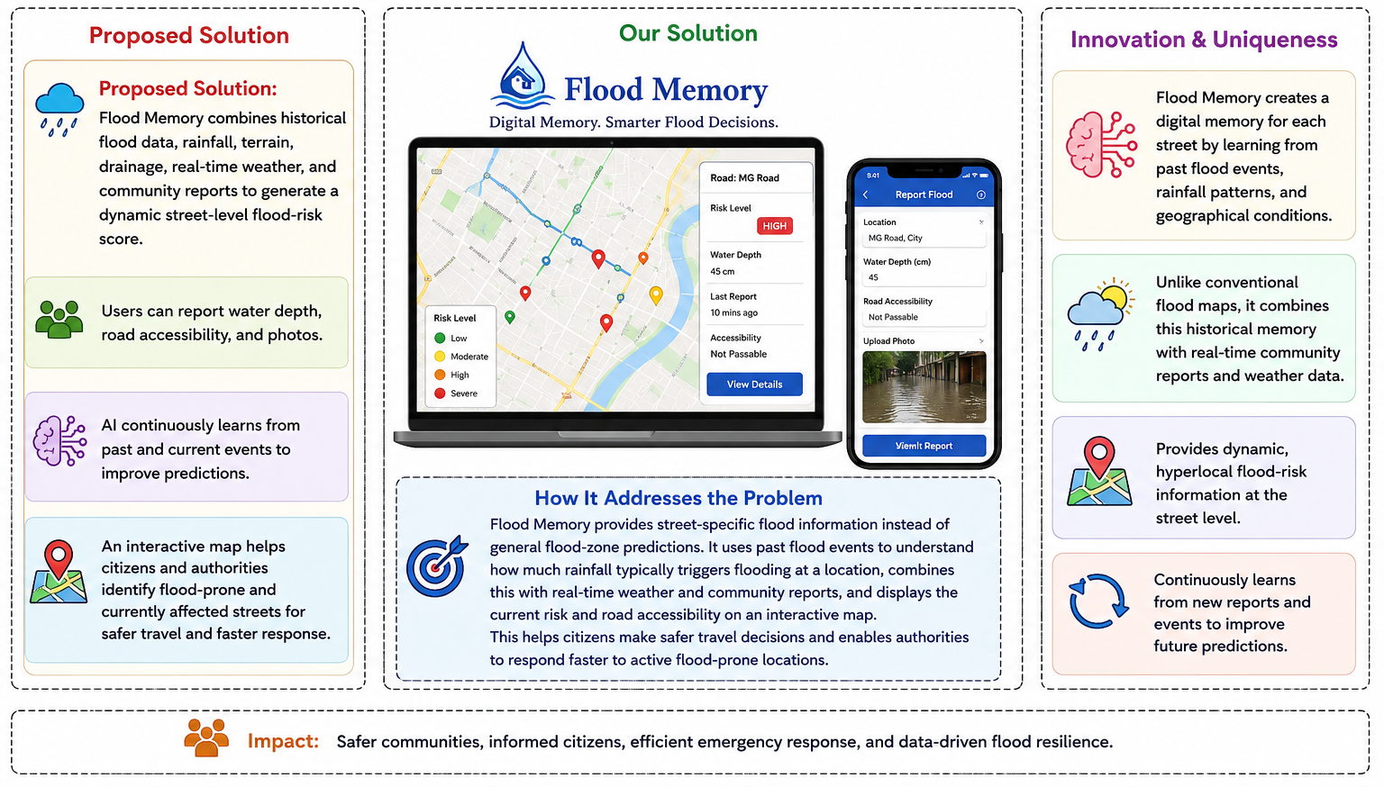

AI-Powered Hyperlocal Flood Intelligence & Community Reporting System
Conservation Programs
Infrastructure Improvements

Slide 3
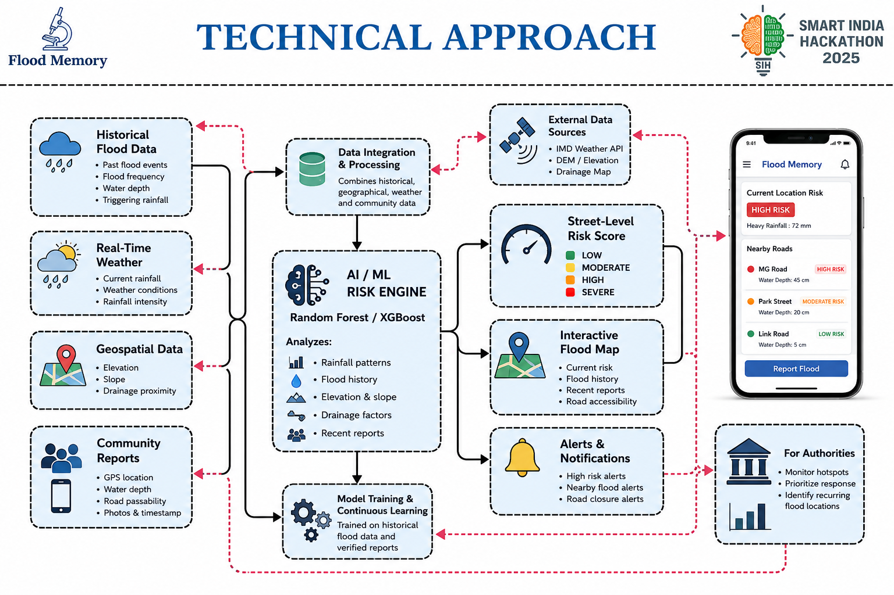


Technical Approach

Slide 4
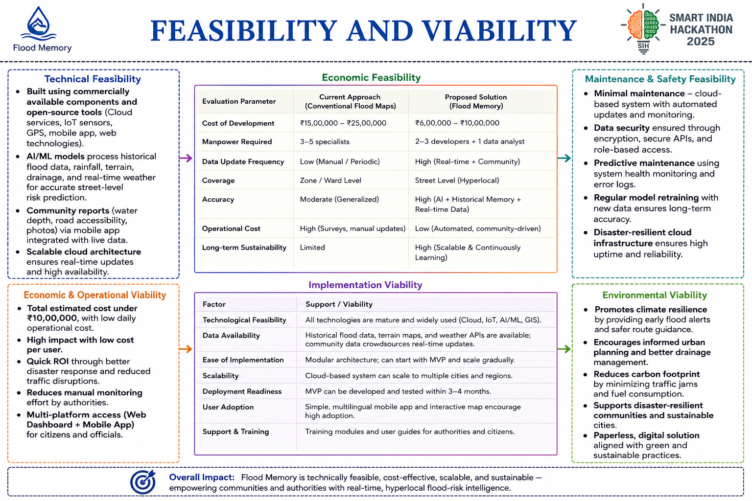


Slide 5




Impact and benefits
Instead of the traditional approach where the focus is on where the flooding occurs, Flood memory analyses the past, the present and starts creating a solution based on the prediction
BENEFITS FOR CITIZENS
Has data of which roads are risky
Avoids flooded roads
Understands rainfall-triggered flood risk
Reports flooding in real time
Shares on-ground evidence
Environmental Benefits
Identify recurring drainage and water-management issues
Supports water and climate research
BENEFITS FOR AUTHORITIES
Identifies frequently flooded streets
Monitors active flood reports
Prioritizes road closures and emergency response
Identifies recurring drainage problems
Supports targeted infrastructure planning
Economic Benefits
Reduces disruption to transport and other businesses
Allows the public to protect their assets and reduce structural damage
Social Benefits
LONG TERM IMPACT
All time flood reports
Better historical database
Better predictions
Better decisions
Safer communities
Improves public safety and emergency response
Enhances risk perception

Slide 6
